Slide 1
BR US Discount Sensitivity GBM model performance
February2017

Slide 2
Data Used for VALIDATION & Observation
Jul 2014- Jun2015
Jul 2015- Jun2016
Behavior
Response and Score Validation
Mean and Median Ensemble are giving similar performance
We are picking median ensemble for obvious advantages

Slide 3
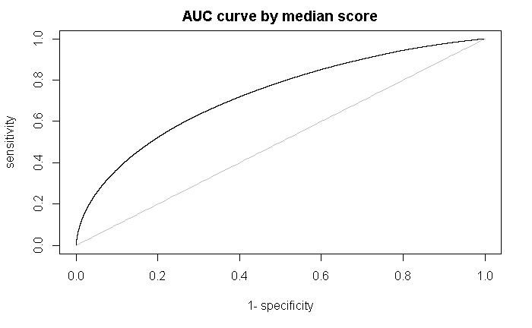

AUC Curve after ensemble
AUC by median ensemble 0.7277817
AUC by mean ensemble 0.7279149

Slide 4
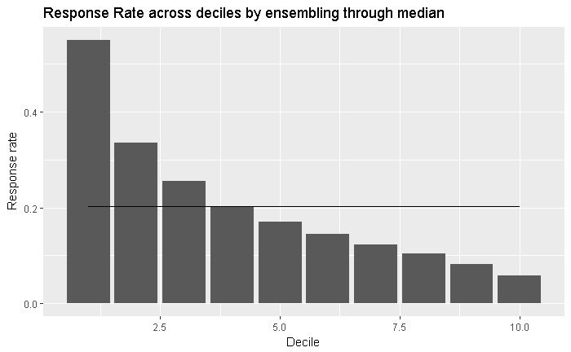

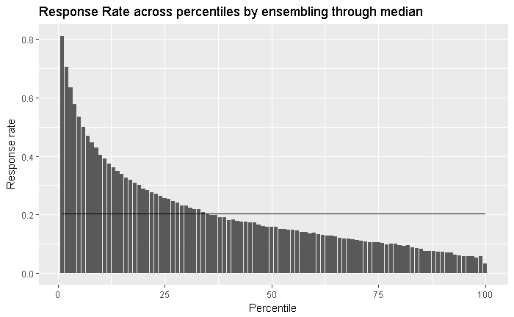
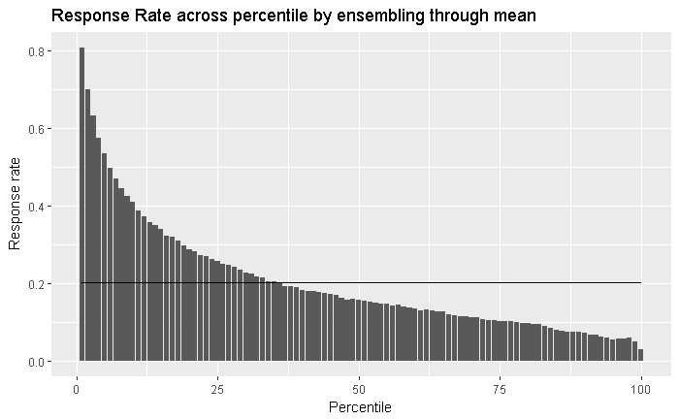
Response Rate Waterfall
Waterfall is well maintained
Response rate by decile/percentiles is higher than overall BAU response rate 0.1634871

Slide 5
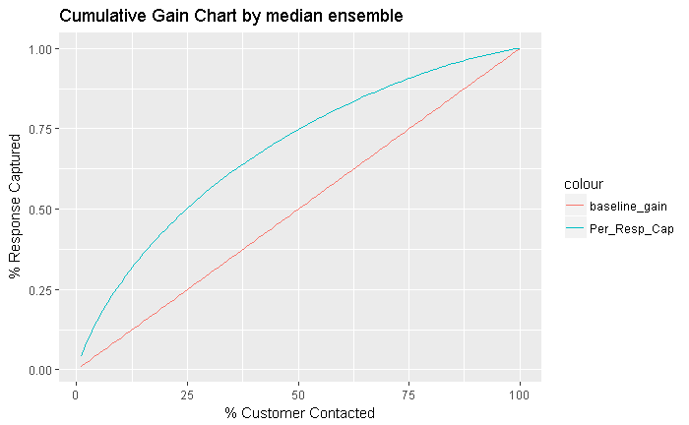
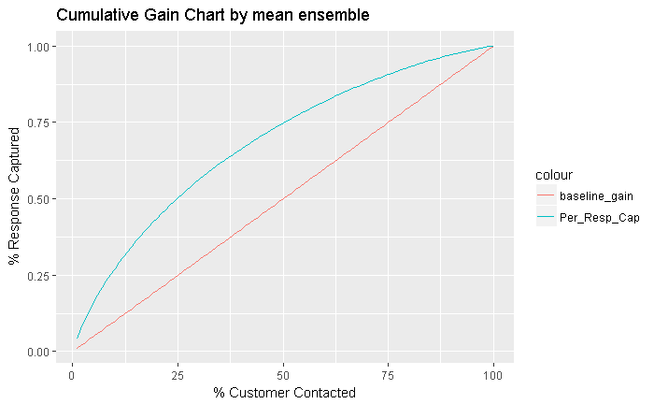
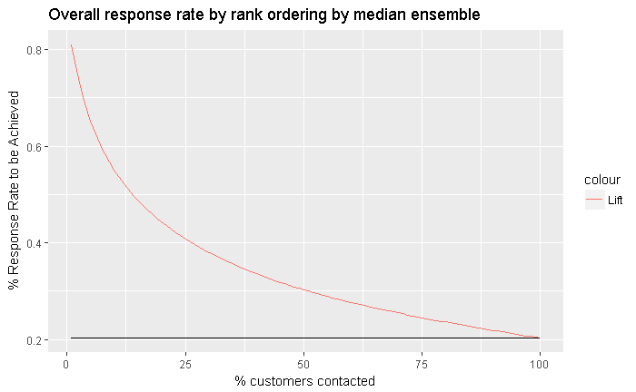
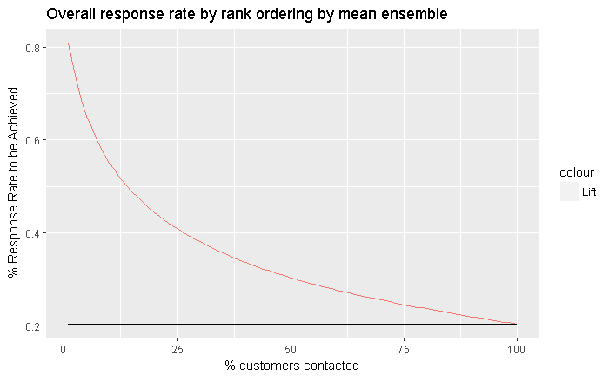
Cumulative Gain Chart and lift chart after ensemble
Overall BAU response rate 0.2026353

